Slide 1

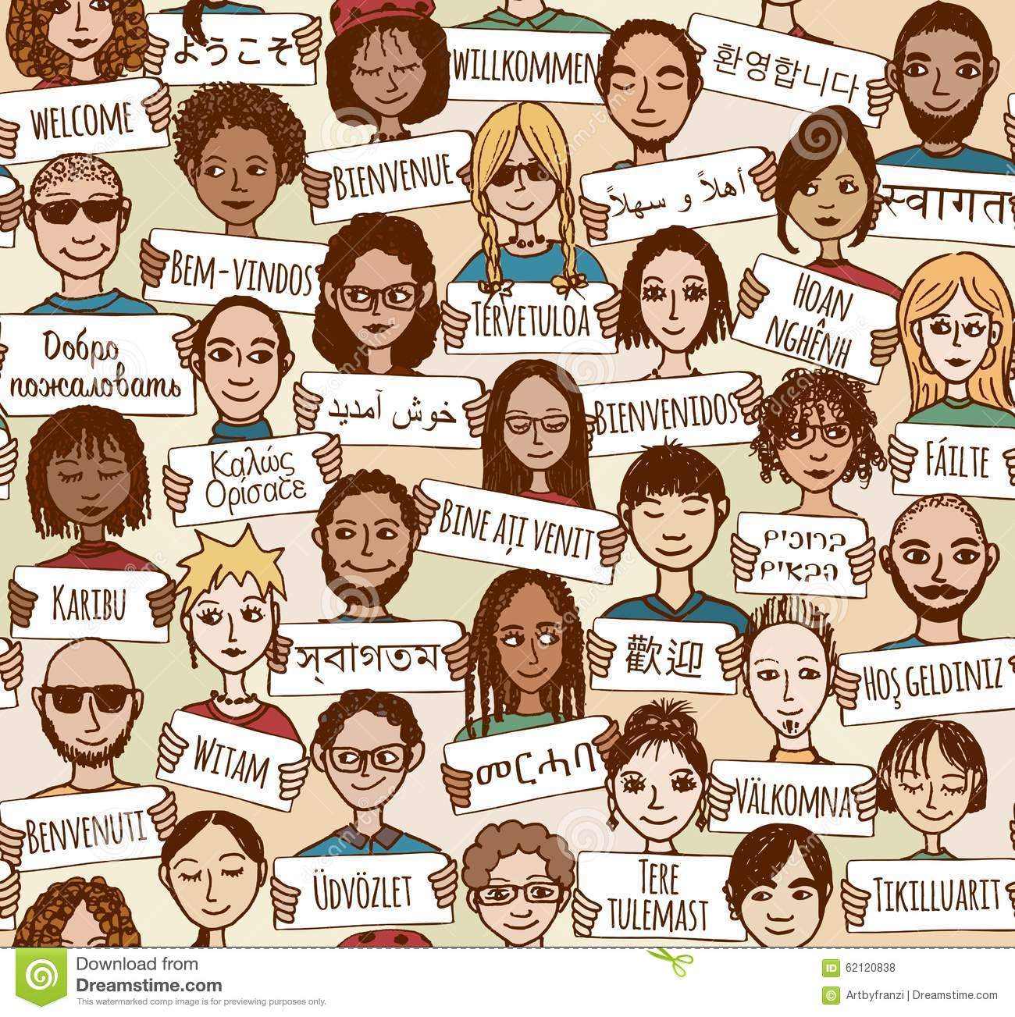

COMPSCI 326
Lecture 08: Basic CSS

Slide 2
Resources
MDN Web Docs
CSS: Cascading Style Sheets
CSS Basics
Pseudo-classes
CSS Grid Layout
Learn CSS Grid in 5 Minutes
Basic Concepts of Grid Layout
CSS Specificity
You can also learn more by watching this:
CSS Grid in 100 Seconds, Fireship

Slide 3

Today
GOAL (in-class exercise): make a 2x2 checkerboard.

Slide 4

Later…
Heading towards an 8x8 checkerboard.

Slide 5
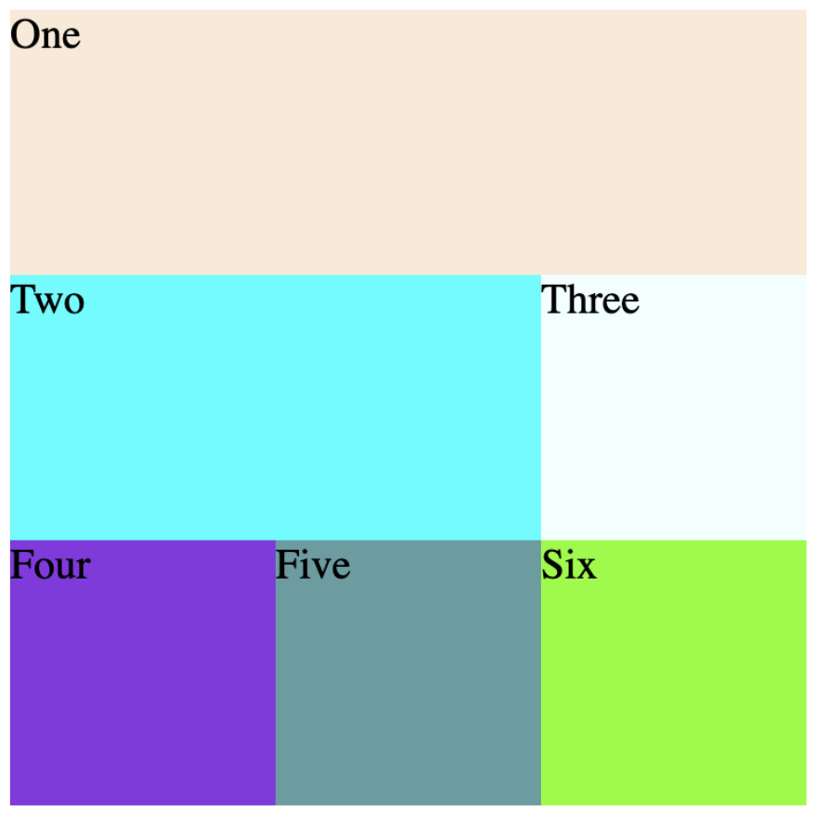
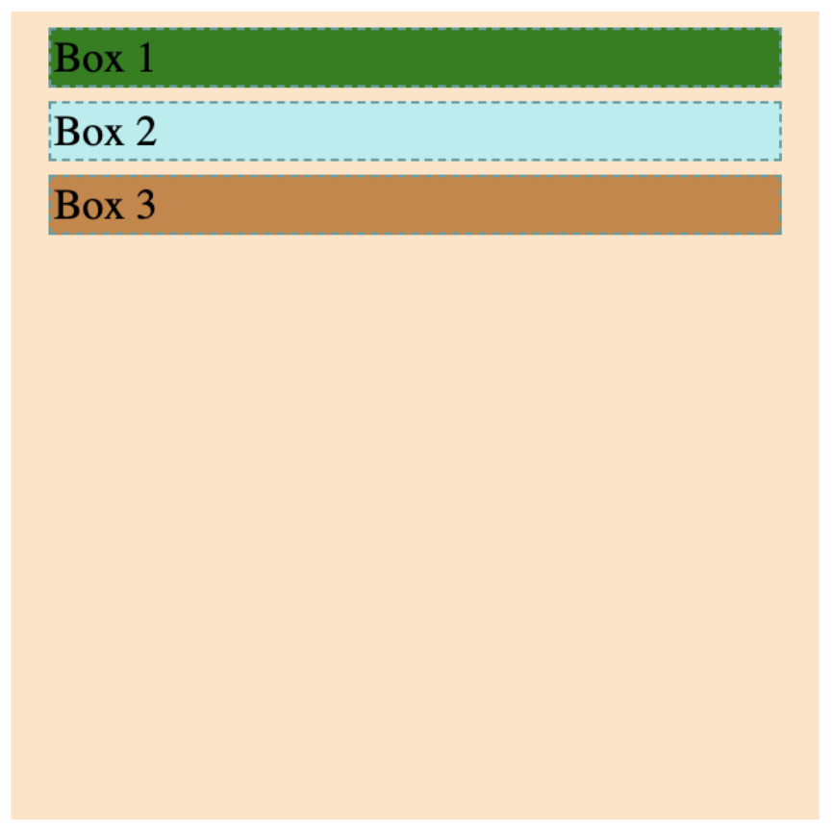
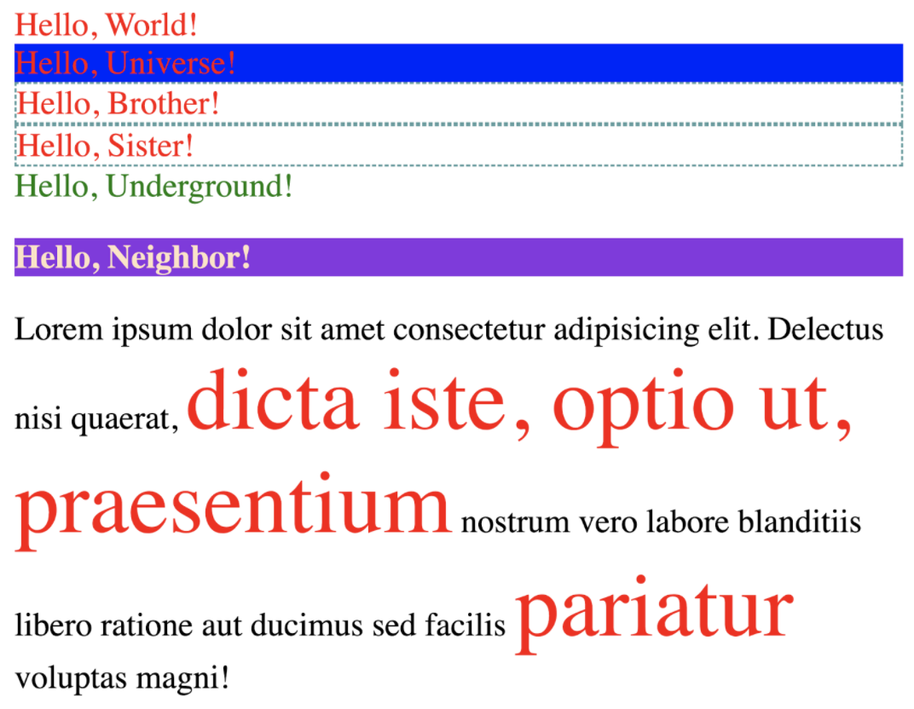
Examples
Let’s take a look at some examples!

